Slide 1
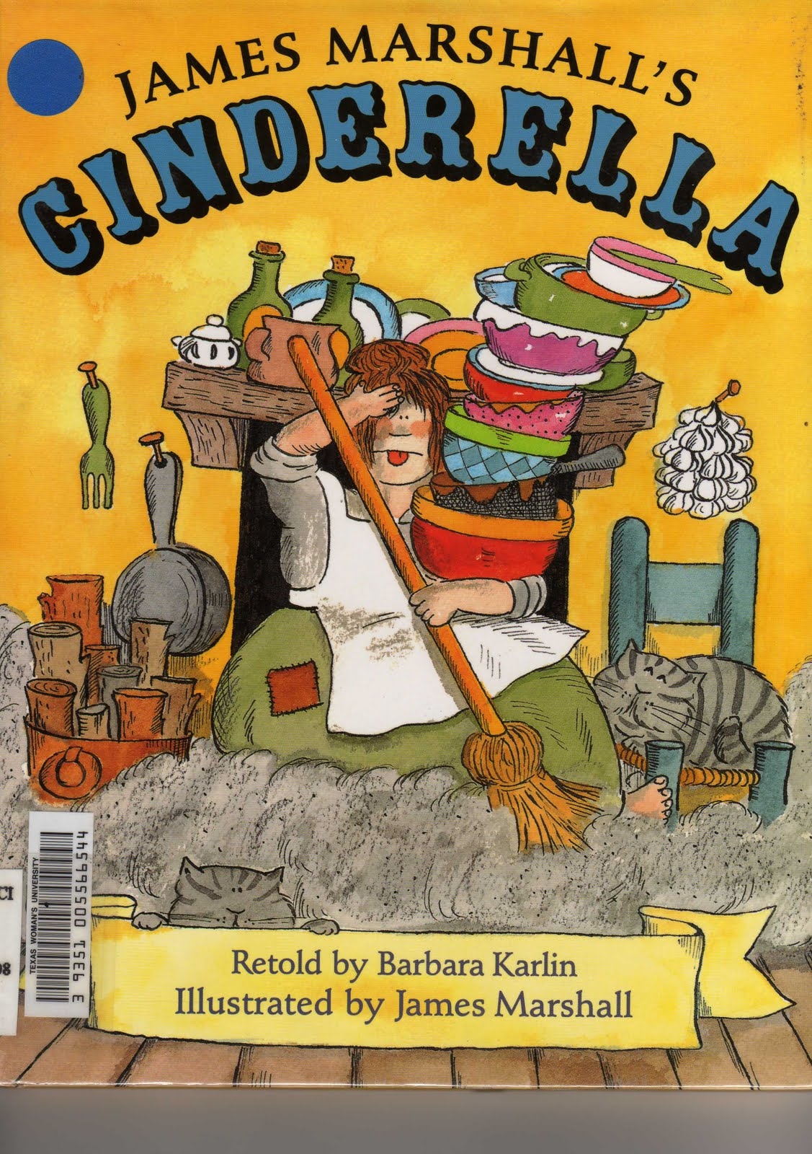

Slide 2
ragged
shrieked
enchanting

Slide 4
beamed
scolded
anxious

Slide 5
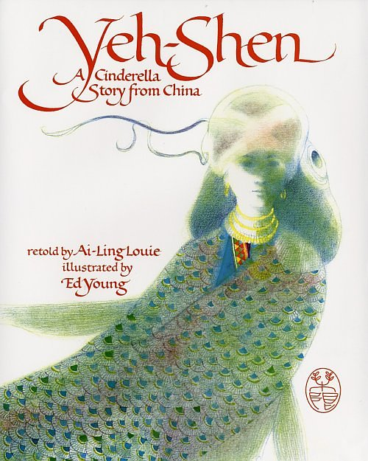

Slide 6
crafty
filthy
tattered

Slide 7
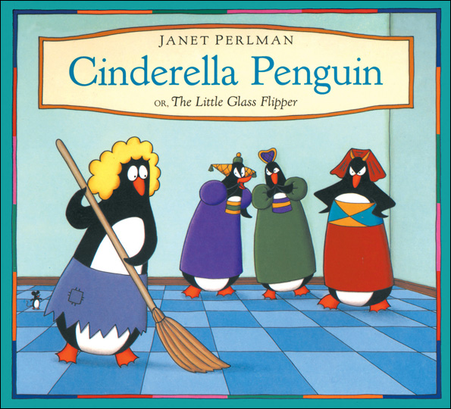

Slide 8
cozy
shabby
delicate

Slide 9
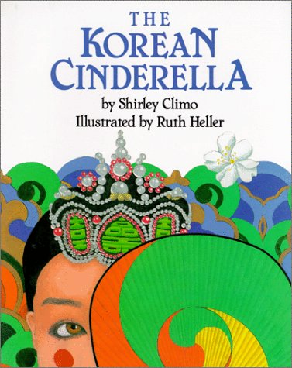

Slide 10
jealous
flustered
glimpse

Slide 11
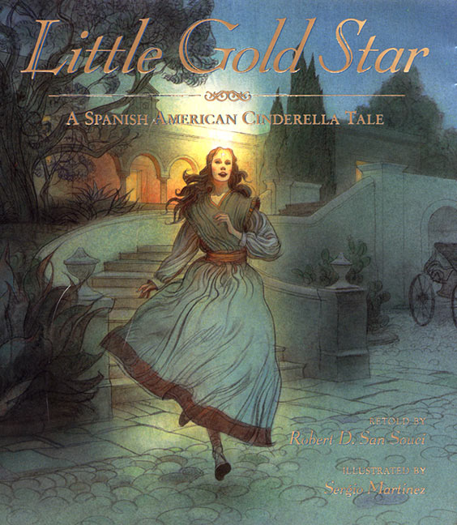

Slide 12
misery
hideous
elegant

